Slide 1
Physics 2415: General Physics II
Lecture 1
Michael Fowler

Slide 2
Basic Outline
The course has three main parts, each about a month:
Electrostatics.
Magnetism and Magnetic Induction.
Electromagnetic Waves.
We’ll cover some other waves, and optical phenomena, in the last few lectures. We’ll also cover DC and AC circuits in the course.

Slide 3
Part I: Electrostatics
Electric Charge and Electric Field
Gauss’ Law
Electric Potential
Capacitance and Dielectrics
(Then we’ll do DC circuits.)

Slide 4
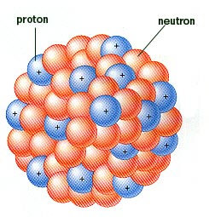
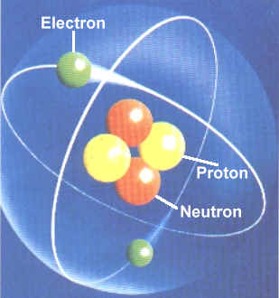
Nuclei and Atoms
An atom consists of a positively charged nucleus surrounded by a cloud of negatively charged electrons. The total electric charge on an un-ionized atom is exactly zero.
Unlike charges attract: the nucleus keeps the electrons in orbit by electrical attraction, just as the planets are held by the Sun’s graviational attraction. But…

Slide 5
Nuclei and Atoms
Unlike planets around the Sun, electrons are only allowed to circle in certain orbits.
(Why this is true is explained by quantum mechanics, and is the basis of the Periodic Table.)
The nucleus contains N nucleons, N = Z + A,
Z protons each having electric charge e, A neutrons, having no charge.
The atom contains Z electrons, charge –e.
The protons in the nucleus all repel each other!

Slide 6
What Holds the Nucleus Together?
The nucleons have a strong but very short range attraction, called the nuclear force, it’s like a thin layer of glue around each nucleon.
The electrostatic repulsion is longer range, and so is more important in bigger nuclei, unlike the nuclear “glue”, which only attracts neighbors.
The electrostatic repulsion is directly responsible for there being only about 100 chemical elements: beyond that, the nuclear glue is overcome and the nucleus flies apart.

Slide 7
Electrostatics in Action… A slow incoming neutron starts a Uranium nucleus wobbling like a drop of water, electrostatic repulsion drives it apart. Larger nuclei will break up without an ingoing neutron.

Slide 8
What Holds Molecules Together?
Molecules are held together by electrostatic attraction, but the details are complicated because allowed electron distribution patterns are determined by quantum mechanics.
Example: the Mickey Mouse water molecule:
The hydrogen atom’s single electron is drawn towards the oxygen nucleus, so the H’s have net positive charge, and are electrostatically attracted to the O.
H
H
H
O

Slide 9
What Holds Solids Together?
For ordinary salt, mainly electrostatics: the Na atom loses an electron to become Na+, an ion, the Cl gains to become Cl-, the ions form a cubic lattice where all the nearest neighbors of a Cl- are Na+’s.

Slide 10
Contact Electrification
If two dissimilar surfaces are placed in close contact, usually some bonding occurs between atoms, and therefore some electron transfer takes place—so when the surfaces are moved out of contact, one will have an excess of electrons, one a deficiency.
True contact at the atomic scale is best achieved by rubbing the surfaces together.

Slide 11
Triboelectric Series
Countless experiments in rubbing things together—cats, balloons, etc.—have established the table on the right.
For two different surfaces, the one higher in the table will lose electrons and become positively charged.
(Note: tribo is from the Greek for rub.)
Electrostatic problem… http://www.youtube.com/watch?v=j1dTSuwz0R8

Slide 12
Positive and Negative Electricity
Ben Franklin did many electrical experiments, some of them crazy, and coined the terms positively charged (meaning, we now know, deficient in electrons) and negatively charged (having extra electrons).

Slide 13
Electric Charge is Always Conserved
That’s obvious when we’re talking about electron transfer by rubbing—but particle accelerators can create protons! It’s found that an antiproton, with negative charge, is always created at the same time.
Creating matter means creating antimatter!

Slide 14
Conductors and Insulators
Some solids—like aluminum—have electrons free to move from atom to atom. These are conductors. They’re usually shiny, because the freely moving electrons reflect light very well.
In solids like NaCl, or glass, etc., the electrons are tied to atoms, no charge can flow: these solids are insulators.
The power is carried by aluminum wires, suspended by glass, polymer, or porcelain insulators.

Slide 15
Attracting Neutrals
a
A neutral conducting ball will be attracted by an electric charge: electrons will move around in the conductor to be closer to an external positive charge, so experiencing stronger force.
For insulators there is sometimes a similar (weaker) effect: the molecules distort to put electrons closer.
a
a
_
+
_
+
_
+
_
+

Slide 16
The Electroscope
Charge detector invented by an English clergyman in 1787. Two very thin strips of gold leaf hang side by side from a conducting rod.
If a + charge is brought near, electrons move up the rod, leaving the two strips positively charged, so they repel each other.

Slide 17
Charging the Electroscope…
By conduction: touch the top conductor with a positively charged object—this will leave it positively charged (electron deficient).
By induction: while holding a positively charged object near, but not in contact, with the top, you touch the electroscope: negative charge will flow from the ground, through you, to the electroscope.

Slide 18
Clicker Question
I charge the electroscope by conduction, touching it with a charged object, which I then remove. The leaves are apart.
I now bring the charged object back close to the electroscope, but not touching it.
The leaves:
Move further apart
Are not affected, if no touching
Move closer together.

