Slide 1
Sources of Magnetic Field II
Physics 2415 Lecture 18
Michael Fowler, UVa

Slide 2
Today’s Topics
More about solenoids
Biot-Savart law
Magnetic materials

Slide 3
Ampère’s Law: General Case
Ampère’s Law states that for any magnetic field generated by a steady flow of electrical currents, if we take an arbitrary closed path in space and integrate around it, then
where now I is the total net current flowing across any surface having the path of integration as its boundary, such as the blue surface shown here.
.

Slide 4
Magnetic Field Inside a Solenoid
Take a rectangular Ampèrian path as shown. Assume the external magnetic field negligible, and the field inside parallel to the axis (a good approximation for a long solenoid). For current I, n turns/meter,
rectangular path of integration
Explore the field here!

Slide 5
Compact Muon Solenoid (CMS)
Maybe the biggest solenoid ever…the strong magnetic field (4T) is inside the central solenoid, inner diameter 6m, length 13m. The field is there to curve the paths of particles produced, to measure their charge and mass. The unit weighs 12,500 tons.

Slide 6
The First Sign of Antimatter
Cloud chamber track of a particle, 1932.
The central line is a lead plate. There is a downward perpendicular B field.
The tighter curvature in the top half means a slower particle—so it came from below. The curvature then tells us it’s a positively charged particle—it’s a positron, an antielectron.
Could it be a proton? No—for the observed curvature, the proton would have to be very slow, and would create many water droplets in this cloud chamber.

Slide 7
Toroidal Solenoid
.
This is doughnut shaped: take an ordinary solenoid, bend it around so the ends meet, and the line along the center of the solenoid becomes a circle. This geometry can contain a plasma without needing end mirrors.
We show here a cross section, like cutting a doughnut for toasting: the current is into the screen at the outside, coming out on the inside.

Slide 8
Field of Toroidal Solenoid
.
Using Ampère’s law to find the field inside the solenoid:
From symmetry, the field points anticlockwise as shown.
The white dashed path is a circle of radius r. The gray surface covering it is cut by every turn of the wire, total current NI.
Ampère’s law
gives immediately

Slide 9
Clicker Question
.
B?
The field outside a toroidal solenoid:
Decreases as 1/r with distance from the center of the solenoid.
Decreases as 1/r².
Is zero.

Slide 10
Clicker Answer
.
B?
The field outside a toroidal solenoid:
Decreases as 1/r with distance from the center of the solenoid.
Decreases as 1/r².
Is zero.
A surface spanning the dotted circle will have zero total current penetrating—as much up as down, so the Ampere integral is zero.

Slide 11
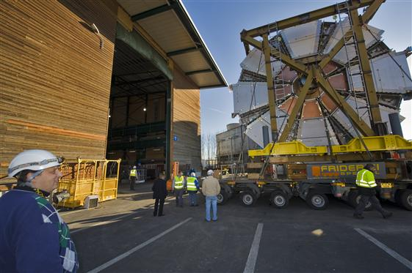
Toroids
.

Slide 12
The Biot-Savart Law
The electric field from any distribution of charges can be found by adding (or integrating) terms from each bit of charge.
The magnetic analog is the Biot-Savart law: for any collection of wire currents, add together fields from current bits:
.
weaker field shown darker

Slide 13
The Biot-Savart Law
Field from a finite length of straight wire:
The field at the point in the figure is inward, and has magnitude
Using R = -y tanθ we find
.
I
0
R
dB
y
r
θ
dy

Slide 14
Clicker Question
Suppose we have two current elements: is at the origin, pointing along the x-axis, is at x = 1, y = 0, z = 0 and points in the z-direction.
Call the force of 1 on 2 .
Does ?
Yes
No
z
y
x

Slide 15
Clicker Answer
Suppose we have two current elements: is at the origin, pointing along the x-axis, is at x = 1, y = 0, z = 0 and points in the z-direction.
Call the force of 1 on 2 .
Does ?
Yes
No
z
y
x
What if the two current elements are just charged particles moving through space? What about Newton’s Third Law? It turns out that the total momentum of the two particles is not conserved: there is momentum carried in the changing electric and magnetic fields.

Slide 16
Field on the Axis of a Current Loop
The vectors and are always at right angles, and adding the contributions from the ‘s going around the circle, only contributions along the axis survive (also obvious from symmetry). The sum of the dℓ’s is 2πR, so the field is
.
r
R
θ
x
I

Slide 17
Ferromagnetic Materials
The atoms of Fe, Co and Ni (and rare earths) are little magnets: in the incompletely filled shell of electrons, the electron spins line up—and electrons are themselves magnets.
The atoms also line up magnetically with their neighbors.
All this lining up is fully explained by quantum mechanics (and cannot be explained otherwise).
So why isn’t every piece of iron magnetic?
.

Slide 18
Domains
Recall the electric field was a store of energy—we’ll see this is also true of the magnetic field. This means materials will tend to arrange themselves to minimize the energy in the magnetic field.
For example, a single crystal of iron will rearrange its atom orientation into domains: the magnetic field is then far smaller.
.

Slide 19
Domains in External Fields In an external magnetic field, the domain structure changes: domains pointing with the applied field grow. The material becomes magnetized.
Barkhausen effect: move a magnet rapidly near magnetic material, and the moving domain walls make a noise as they move past impurities, etc. Useful for assessing material quality.

Slide 20
Hard and Soft Magnetic Materials
We’ve seen how the domains can grow and shrink in response to external fields. How readily this happens for a particular material depends on how easily the domain walls can move. They can get hung up on lattice defects or impurities, etc.
A soft magnet (iron) has domain walls that move easily. It readily becomes magnetized in an external field, but can easily lose that magnetization if subject to vibration.
A permanent magnet is less easy to produce, but keeps its magnetization—domain walls don’t move easily.

Slide 21
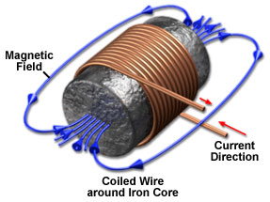
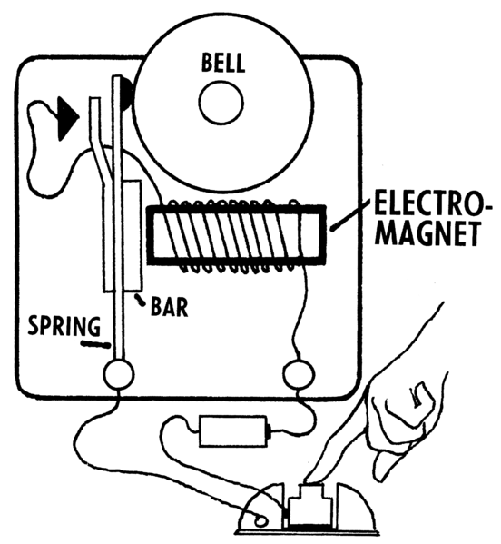
Electromagnets
Electromagnets are solenoids with iron inside to magnify the magnetic field.
In the electromagnetic doorbell, pressing the button closes the circuit, the magnet pulls the bar and small hammer forward to ring the bell—and also to break the circuit, which passes along the bar to a contact at the top. The cycle repeats as long as the button is pressed.
.

