Slide 1
Optical Instruments
Physics 2415 Lecture 34
Michael Fowler, UVa

Slide 2
Today’s Topics
The lensmaker’s formula
Magnifying power
Lens combinations: ray tracing, telescopes.

Slide 3
Refraction at a Spherical Surface
Rays close to the axis (“paraxial”) will focus to an image inside the glass:
From
we can show that
P
h
C
O
R
I
air
glass
d_{o}
d_{i}

Slide 4
The Lensmaker’s Formula
(optional derivation, if you’re curious)
The formula also works in reverse. A ray coming from an object in the glass will satisfy
For a convex lens with surfaces of radii R₁, R₂, the rays on going through R₁ will converge (inside the glass) towards a point d₁ such that .
But those rays don’t get there—they first meet surface R₂, which focuses them in air to a point d_{i}, say, these rays being from a virtual object at d₁, so the object distance is –d₁, the final image is at d_{i}:
Adding the boxed formulas gives:

Slide 5
The Lensmaker’s Formula
This formula also works for plano convex lenses (one side flat, meaning R infinite) or if one or both sides are concave—but for concave sides, R must be taken negative.
Note: sometimes this formula is written with a minus sign—in those books, the rule is that R is taken positive if its center of curvature over is to the right. It’s a matter of taste.

Slide 6
Image Location by Ray Tracing
The rules we use for thin lenses:
We take the ray through the center of the lens to be undeflected and unshifted.
For a convex lens, rays passing through a focus on one side are parallel to the axis on the other side.
For a concave lens, rays coming in parallel on one side are deflected so they apparently come from the focal point on that same side.

Slide 7
Ray Tracing for a Thin Convex Lens
O´
B
h_{o}
f
F
d_{i} - f
I
O
d_{o}
A
d_{i}
h_{i}
We choose the ray through the lens center, a straight line in our approximation, and the ray parallel to the axis, which must pass through the focus when deflected. They meet at the image.
I´
From the straight line through the center, from the line BFI´ (and similar triangles!),
This gives immediately:

Slide 8
Convex Lens as Magnifying Glass
The object is closer to the lens than the focal point F. To find the virtual image, we take one ray through the center (giving ) and one through the focus near the object ( ), again but
now the (virtual) image distance is taken negative.
h_{i}
h_{i}
h_{o}
F
d_{o}
f - d_{o}
f
d_{i}

Slide 9
Definition of Magnifying Power
M is defined as the ratio of the angular size of the image to the angular size of the object observed with the naked eye at the eye’s near point N, which is h_{o}/N.
If the image is at infinity (“relaxed eye”) the object is at f, the magnification is (h_{o}/f )/(h_{o}/N) = N/f.
Maximum M is for image at N, then M = (N/f ) + 1.
h_{i}
h_{i}
F
h_{o}
f - d_{o}
d_{o}
f
d_{i}

Slide 10
Simple and Compound Microscopes
The simple microscope is a single convex lens, of very short focal length. The optics are just those of the magnifying glass discussed above.
The simplest compound microscope has two convex lenses: the first (objective) forms a real (inverted) image, the second (eyepiece) acts as a magnifying glass to examine that image.
The total magnification is a product of the two: the eyepiece is N/f_{e}, N = 25 cm (relaxed eye) the objective magnification depends on the distance  between the two lenses, since the image it forms is in the focal plane of the eyepiece.

Slide 11
Diverging (Concave) Lens
The same similar triangles arguments here give
from which
provided we now take both d_{i} and f as negative!
.
h_{o}
h_{o}
h_{i}
F
f – d_{i}
d_{i}
f
d_{o}

Slide 12
Formula Rules Updated…
The formula
is valid for any thin lens.
For a converging lens, f is positive, for a diverging lens f is negative.
The object distance d_{o} is positive—unless, in a multi-lens system, the object is on the “wrong” side of the lens! (We’ll do an example.)
The image distance d_{i} is positive for a real image, negative for a virtual image.

Slide 13
Empty Lens
A “concave lens” is actually made of very thin glass, is hollow and filled with air.
How will this lens behave at close quarters under water?
1) It will magnify
2) Things will look smaller
3) Things will look the same size

Slide 14
Empty Lens
A “concave lens” is actually made of very thin glass, is hollow and filled with air.
How will this lens behave at close quarters under water?
1) It will magnify
2) Things will look smaller
3) Things will look the same size

Slide 15
Clicker Question
I have two identical thin convex lenses of focal length f. If I put them together ()(), what is the focal length of the combination?
2f
f
f/2

Slide 16
Clicker Answer
f/2 : the first lens refracts the rays towards a focus at f, they immediately encounter the second lens, which refracts them more, to a closer focus.
Important! The image from the first lens is the object for the second lens.
Combined focal length from formula: for the second lens, , the object is behind the lens!
From we have
.

Slide 17
Two Convex Lenses Separated
Easy example: two lenses, same focal length f, separated by f , so rays through the center of one lens are parallel to the axis after (or before) passing through the other lens:
This would be the real image for lens A alone, it is the object for lens B.
A
B
object
image
f

Slide 18
Further Separated…
If the first lens forms an image between the lenses, but less than the focal distance to the second lens, the combination produces a virtual image (this is the basic ray pattern for simple telescopes and microscopes):
This is the real image from the first lens
The ray shown purple is the one parallel to the axis between the lenses—so it passes through both foci outside the system
This is the final virtual image: notice it’s upside down—that’s OK for astro telescopes.

Slide 19
Even More Separated…
If the separation is sufficient that the image from the first lens A is outside the focal length of lens B, there is a final real upright image beyond the second lens:
A
B
We first locate the image from lens A, then draw in the ray from it through the center of lens B
Notice the usefulness of the ray parallel to the axis between the lenses—it goes through the foci (white circles) outside.

Slide 20
The Spyglass
The real image from the two convex lenses can be viewed through a third, powerful, lens to make a telescope with upright image, better for terrestrial viewing (as opposed to astronomical uses).

Slide 21
Astronomical Telescope: Angular Magnification
Any object in astronomy can be taken to be at infinite distance: the relevant image size parameter is the angular size of the image.
Example: imagine pointing a telescope at Jupiter, so Jupiter’s south pole is on the axis of the telescope.
Rays coming from Jupiter’s north pole can be taken to be parallel and at a small angle to the axis on entering the telescope, so they form an image in the focal plane…
A
B
f_{A}

Slide 22
Astronomical Telescope: Angular Magnification
An “eyepiece” lens of shorter focal length is added, with the image from lens A in the focal plane of lens B as well, so viewing through B gives an image at infinity.
Tracking the special ray that is parallel to the axis between the lenses (shown in white) the ratio of the angular size image/object, the magnification, is just the ratio of the focal lengths f_{A}/f_{B}.
A
B
f_{A}
f_{A}
f_{B}
f_{B}

Slide 23
Galilean Telescope
The rays from the object lens are intercepted by a concave lens before they form an image. The concave lens is positioned so that the image would have been at its focus—so it forms a virtual image at infinity (from the lens formula).
The angular magnification is again the ratio of focal lengths.
f_{B}
f_{B}
f_{A}

Slide 24
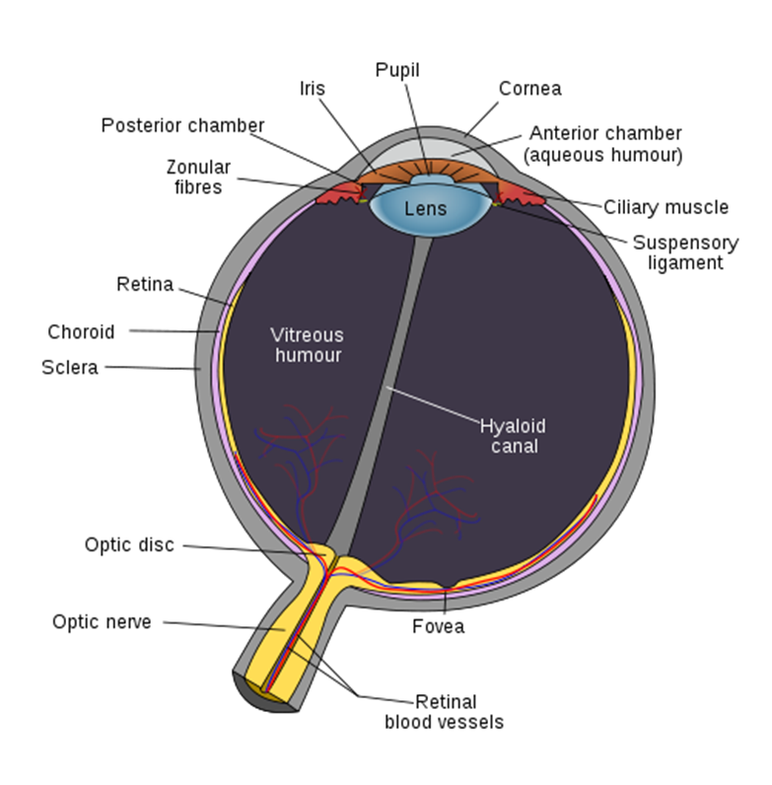
The Eye
Most of the focusing takes place at the cornea, filled with watery stuff.
The lens shape is adjusted by muscles to make finer adjustments to the focusing.

